Slide 1


Associations
and Additional annotations

Slide 2
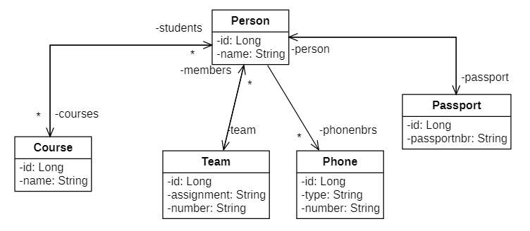
Problem statement
How does JPA deal with associations that may occur in a class diagram?
How do you "map" the entities that have associations with corresponding tables in the database?

Slide 3
We distinguish 4 different cardinalities
 | In the Entity | In the database
1 --- 1 (1 to 1) | @OneToOne Reference to one object | In the table corresponding to this entity there is a FK that establishes the association with the other entity
* --- 1 (many to 1) | @ManyToOne Reference to one object | In the table corresponding to this entity there is a FK that establishes the association with the other entity
1 --- * (1 in many) | @OneToMany Reference via collection attribute | In another table, the primary key of the table corresponding to this entity will be a FK. (that establishes the association with this entity).
*---* (much on much) | @ManyToMany Reference via collection attribute | In another table, the primary key of the table corresponding to this entity will be a FK. (that establishes the association with this entity).

Slide 4
Structure
Associations lesson example with explanation
1 on 1: @OneToOne for Person - Passport
Many on 1: @ManyToOne for Person - Team
1 to many: @OneToMany for Person - Phone
Much on much: @ManyToMany for Person - Course
Direction of association
Additional annotations

Slide 5
Making Associations Example

Slide 6
Contents
This presentation will guide you through the implementation of associations in a JPA project.
Follow these instructions carefully and you will learn what to do and how to do it.
The project that came with this item is only for use in case you don't manage to make it yourself. It is best to use the (tele)coaching than...
Good luck!

Slide 7
Structure
This presentation will show you how to implement associations in JPA. The following cardinalities are dealt with in this example:
1 to 1: @OneToOne for Person - Passport
Many to 1: @ManyToOne for Person - Team
1 to many: @OneToMany for Person - Phone
Many to many: @ManyToMany for Person - Course

Slide 8
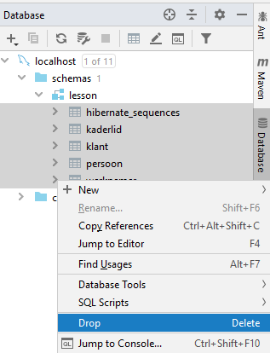
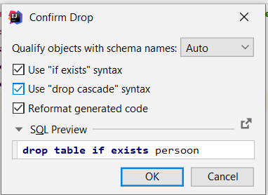
Making a lesson example: Associations
Step 0: Delete/drop the person table in your database
In the inheritance project, you created a person table. In this project, you will also create a person table, but it must look different from the one in the previous project. Therefore, you should first remove all tables from the database:
Select all tables, right-click on a table and choose Drop
Then click on the following checkboxes and click OK:

Slide 9
Making of the lesson example: Associations
Step 1: Rename and open the startproject in your corresponding GitHub folder
Step 2: Create the entities "Person", "Passport", “Course", "Team" and "Phone".
See presentation Lesson 3 JPA to know how to create entities
Complete with the attributes shown in the class diagram
Generate the no-arg constructor and getters and setters in each entity
Implement all associations according to the indicated cardinality
@OneToOne for Person - Passport
@ManyToOne for Person - Team
@OneToMany for Person - Phone
@ManyToMany for Person - Course

Slide 10
1 - 1:
@OneToOne

Slide 11
Edit Person.java for @OneToOne implementation
@Entity
public class Person{
@Id
@GeneratedValue(strategy = GenerationType.AUTO)
private Long id;
private String name;
@OneToOne (cascade={CascadeType.ALL})
private Passport;
...
@Override
public String toString() {
return name;
}
}
Also generate the getter and setter for passport!
Notes:
We need the toString() method to be able to show the persons in a dropdownlist later on

Slide 12
Modify Passport.java for @OneToOne implementation
@Entity
public class Passport{
@Id
@GeneratedValue(strategy = GenerationType.AUTO)
private Long id;
@OneToOne(mappedBy= "passport")
private Person person;
...
private String passportnbr;
}
Also generate the getter and setter for person!

Slide 13
* - 1:
@ManyToOne

Slide 14
Person.java
@Entity
public class Person {
@Id
@GeneratedValue(strategy = GenerationType.AUTO)
private Long id;
private String name;
@OneToOne(cascade={CascadeType.ALL})
private Passport;
@ManyToOne
private Team team;
. . .
}
Also generate the getter and setter for team!

Slide 15
Team.java
@Entity
public class Team{
@Id
@GeneratedValue(strategy = GenerationType.AUTO)
private Long id;
private String assignment;
private String number;
@OneToMany(mappedBy="team")
private List<Person> members = new ArrayList<>();
. . . //instantiate that collection immediately
public String toString() {
return assignment + " ("+number+")";
}
}
Also generate the getter and setter for members!

Slide 16
1 - *:
@OneToMany

Slide 17
Person.java
@Entity
public class Person{
@Id
@GeneratedValue(strategy = GenerationType.AUTO)
private Long id;
private String name;
@OneToOne (cascade={CascadeType.ALL})
private Passport passport;
@ManyToOne
private Team team;
@OneToMany
private List<Phone> phonenbrs = new ArrayList<>();
// Always instantiate that collection immediately!
...
public void addPhonenbr(String type, String number){
Phone phone = new Phone();
phone.setType(type);
phone.setNumber(number);
this. phonenbrs.add(phone);
}
}
Also generate the getter and setter for phonenbrs!

Slide 18
Phone.java
@Entity
public class Phone{
@Id
@GeneratedValue(strategy = GenerationType.AUTO)
private Long id;
private String type;
private String number;
//No need to add an extra attribute: the association is only drawn in one direction in the class diagram!
public Phone() {
}
. . .
}

Slide 19
* - *:
@ManyToMany

Slide 20
Person.java
@Entity
public class Person{
@Id
@GeneratedValue(strategy = GenerationType.AUTO)
private Long id;
private String name;
@OneToOne (cascade={CascadeType.ALL})
private Passport passport;
@ManyToOne
private Team team;
@OneToMany
private List<Telephone> phonenrs = new ArrayList<>();
@ManyToMany
private List<Course> courses = new ArrayList<>(); ...
}
Also generate the getter and setter for boxes!

Slide 21
Course.java
@Entity
public class Course{
@Id
@GeneratedValue(strategy = GenerationType.AUTO)
private Long id;
private String name;
@ManyToMany(mappedBy="courses")
private List<Person> students = new ArrayList<>();
// Always instantiate that collection immediately!
...
}
Also generate the getter and setter for students!

Slide 22
Making a lesson example: Associations
Step 3: Create repository for entities "Person" and "Team
See presentation Lesson 3 JPA to know how to do this
=> PersonRepository and TeamRepository

Slide 23
Step 4: Create MainController
Now create the MainController:
See presentation Lesson 0 MVC to know how to create a controller
Create association with PersonRepository and TeamRepository
Use the following methods:
Method to display the index page
Method to display the addTeam page where you can enter the details of a new Team
Method to create a new Team object with these data after passing the data from the addTeam page, store this team in the database and then display the index page
Method to display the addPerson page where you can enter the data of a new Person
Method, after passing the data from the addPerson page, to create a new Person object with this data, to store this person in the database and then to display the index page
Method to display the addPhone page where you can enter a new phone number for a person
Method, after forwarding the data from the addPhone page, to associate a new telephone number with the selected person, to store this modified person in the database and then to display the index page

Slide 24
Step 4: Create MainController
@Controller
public class MainController {
private PersonRepository personRepository;
private TeamRepository teamRepository;
public MainController(PersonRepository personRepository, TeamRepository teamRepository) {
this.personRepository = personRepository;
this.teamRepository = teamRepository;
}
@RequestMapping("/")
public String index(Model model) {
List<Team> list = teamRepository.findAll();
model.addAttribute("teamList", list);
return "index";
}
@RequestMapping("/addTeam")
public String addTeam() {
return "addteam";
}
@RequestMapping("/processAddTeam")
public String processAddTeam(Model model, HttpServletRequest request) {
String assignment = request.getParameter("assignment");
String number = request.getParameter("number");
Team team = new Team();
team.setAssignment(assignment);
team.setNumber(number);
teamRepository.save(team);
List<Team> list = teamRepository.findAll();
model.addAttribute("teamList", list);
return "index";
}

Slide 25
Step 4: Create MainController (continued)
@RequestMapping("/addPerson")
public String addPerson(Model model) {
List<Team> list = teamRepository.findAll();
model.addAttribute("teamList", list);
return "addPerson";
}
@RequestMapping("/processAddPerson")
public String processAddPerson(Model model, HttpServletRequest request) {
String name = request.getParameter("name");
long teamId = Long.parseLong(request.getParameter("teamIndex"));
Optional<Team> team = teamRepository.findById(teamId);
Person person = new Person();
person.setName(name);
if (team.isPresent()) { person.setTeam(team.get()); }
personRepository.save(person);
List<Team> list = teamRepository.findAll();
model.addAttribute("teamList", list);
return "index";
}
@RequestMapping("/addphone")
public String addTelephone(Model model) {
List<Person> list = personRepository.findAll();
model.addAttribute("personList", list);
return "addPhone";
}
@RequestMapping("/processAddPhone")
public String processAddTelephone(Model model, HttpServletRequest request) {
String type = request.getParameter("type");
String number = request.getParameter("number");
long personId = Long.parseLong(request.getParameter("personIndex"));
Person = personRepository.findById(personId).get();
person.addPhonenbr(type, number);
personRepository.save(person);
List<Team> list = teamRepository.findAll();
model.addAttribute("teamList", list);
return "index";
}
}

Slide 26
Making a lesson example: Associations
Step 5: Create user interface:
index.html
addTeam.html
addPerson.html
addPhone.html

Slide 27
Step 5: Create user interface index.html
Now it remains to create a user interface. Adjust the body of index.html so that new teams and persons can be registered and so that an overview is given of already registered teams and their members with their telephone numbers:
<body>.
< ol>
<li th:each="team : ${teamlist}" ><span th:text="${team.get.getAssignment()}" />
< ol>
<li th:each="member : ${team.getMembers()}">
<span th:text="${member.getName()}" />
<span th:text="'(passportnbr: '+${member.getPassport().getPassportnbr()+')'}"></span>
< ul>
<li th:each="tel : ${member.getPhonenrs()}">
<span th:text="${tel.getType()} + ': ' + ${tel.getNumber()}" />
</li>
</ul>
</li>
</ol>
</li>
</ol>
< br/>
<p><a href="/addTeam">Add team</a></p>
<p><a href="/addPerson">Add a person to a team</a></p>
<p><a href="/addPhone">Add phone number</a></p>
</body>.

Slide 28
Step 5: Create user interface addTeam.html
Now we have to add the pages addTeam.html and addPerson.html. We start with the body of addTeam.html:
<body>.
<h1>Make Team</h1>
<form action="/processAddTeam" >
<p>
<label for="assignment">Assignment:</label>
<input type="text" name="assignment" id="assignment">
</p>
<p>
<label for="number">Number:</label>
<input type="text" name="number" id="number">
</p>
<p>
<input type="submit" value="Save" name="save">.
</p>
</form>.
</body>.

Slide 29
Step 5: Create user interface addPerson.html
We will now work on addPerson.html:
<body>.
<h1>Make Person</h1>
<form action="/processAddPerson" >
<p>
<label for="name">Name:</label>
<input type="text" name="name" id="name">
</p>
<p>
<label for="passport">Passport number:</label>
<input type="text" name="passport" id="passport">
</p>
<p>
<select name="teamIndex">
<option value = "-1">Choose a team </option>
<option th:each= "team: ${teamList}" th:text="${team.toString()}" th:value="${team.getId()}" ></option>
</select>.
</p>
<p>
<input type="submit" value="create team member" name="create team member">.
</p>
</form>.
</body>

Slide 30
Step 5: Create user interface addPhone.html
We are now working on addPhone.html:
<body>.
<h1>Create a Phone Number for a Person</h1>.
<form action="/processAddPhone" method="post">
<p>
<select name="personIndex">
<option th:each= "person: ${personlist}" th:text="${person.toString()}" th:value="${person.getId()}" ></option>
</select>.
</p>
<p>
<label for="type">Type:</label>.
<input type="text" name="type" id="type">
</p>
<p>
<label for="number">Number:</label>
<input type="text" name="number" id="number">
</p>
<p>
<input type="submit" value="create phone number" name="create phone number">.
</p>
</form>.
</body>.

Slide 31
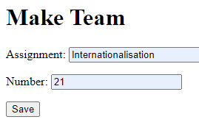
Application testing
We use the just created html pages to create 2 teams:
Team 1: Assignment: Internationalisation, Number: 21
Team 2: Assignment: Herbalist, Number: 22
We populate each team with some team members
Team member 1: Name: Mark Roets, passport number: 12587-258648-21 Team: Internationalisation (21)
Team member 2: Name: Jo Goossens, passport number: 587469-256413-58 Team: Internationalisation (21)
Team member 3: Name: Bert Gevers, passport number: 2584-258947-36 Team: Herbalist (22)
Team member 4: Name: Pieter De Belder, passport number: 25489-369587-59 Team: Herbalist (22)
Team member 5: Name: Kenny De Boeck, passport number: 589748-958674-29 Team: Internationalisation (21)

Slide 32
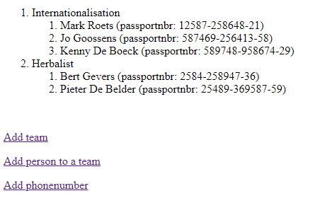
index.html
Result:

Slide 33
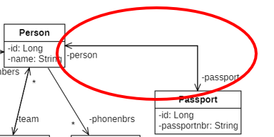
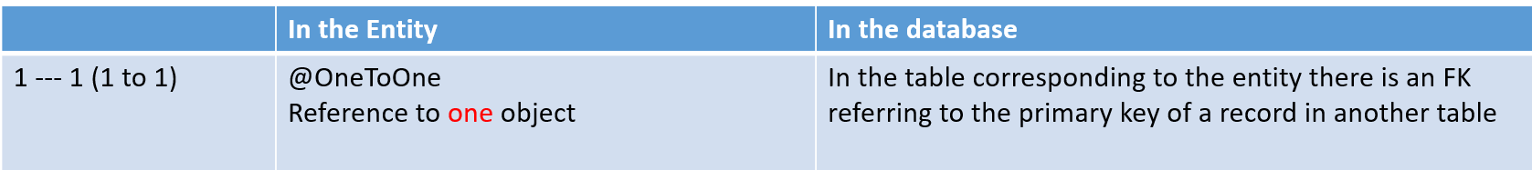
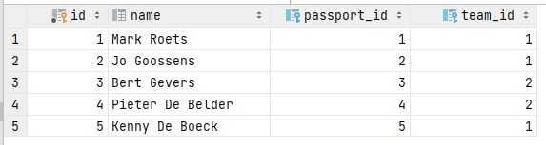
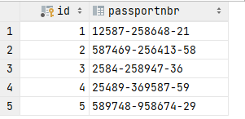
In the database
In the class Person:
@OneToOne(cascade={CasadeType.ALL})
private Passport passport;
In the Passport class:
@OneToOne(mappedBy=“passport")
private Person person;

Slide 34
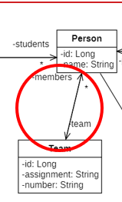
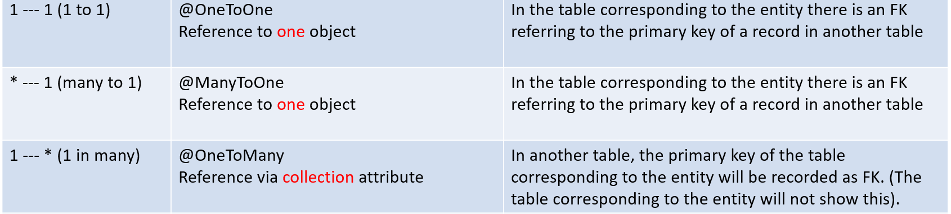
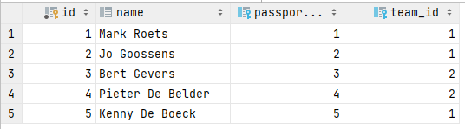

In the database
In the class Person:
@ManyToOne
private Team team;
In the Team class:
@OneToMany(mappedBy="team")
private List<Person> members = new ArrayList<>();

Slide 35
Bidirectional @OneToOne and @OneToMany
Each person has one passport and one passport belongs to one person:
Bidirectional so we are able to access the passport of a person and access the person to which the passport belongs
In class Person and Passport we have @OneToOne annotation
Each person belongs to exactly one team. Each team consists of several members.
Bidirectional so we are able to access the members of each team and also want to know to which team each person belongs
In class Team we have an @OneToMany annotation
In class Person we use the @ManyToOne annotation

Slide 36
Person.java
@Entity
public class Person{
@Id
@GeneratedValue(strategy = GenerationType.AUTO)
private Long id;
private String name;
@OneToOne (cascade={CascadeType.ALL})
private Passport;
@ManyToOne
private team;
. . .
}
Table PERSON gets FK to table PASSPORT and when saving a new person, the associated passport will also be created and saved (cascade=…)
Table PERSON gets FK to table TEAM and when saving a new person, the team to which you want to link this new person already exists (and doesn’t need to be created => no cascade)

Slide 37
Passport.java
@Entity
public class Team{
@Id
@GeneratedValue(strategy = GenerationType.AUTO)
private Long id;
@OneToOne(mappedBy="passport")
private Person person;
. . .
}
Association is achieved by FK in table PERSON in the column defined by the attribute passport

Slide 38
Team.java
@Entity
public class Team{
@Id
@GeneratedValue(strategy = GenerationType.AUTO)
private Long id;
private String assignment;
private String number;
@OneToMany(mappedBy="team")
private List<Person> members = new ArrayList<>();
. . .
}
Association is achieved by FK in table PERSON in the column defined by the attribute team

Slide 39
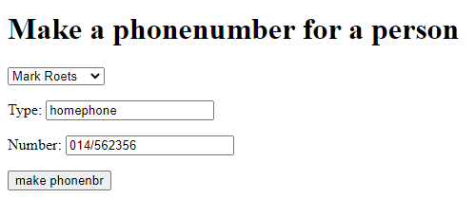
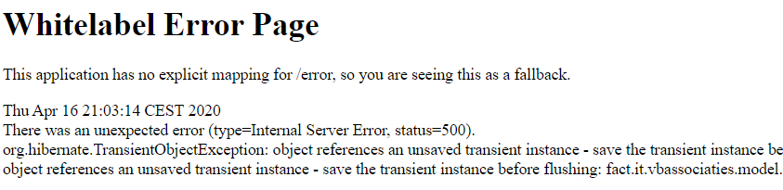
Application testing
We now also add a telephone number:
We get this error message:

Slide 40
Application testing
Error message: "Object references an unsaved transient instance - save the transient instance before flushing: fact.it.vbassociations.model.Phone
Explanation: We write a person object to the database, but this person has a phone object attached to it which is not yet in the database. We have to make sure that the phone is written to the database together with the person.
To solve this problem, we adjust the annotation to the telephone numbers as follows.
@OneToMany(cascade={CascadeType.ALL})
private List<Phone> phonbrs = new ArrayList<>();
This addition ensures that any database operation on person (such as saving and deleting) is also done on the phone numbers (in the same way as we did for «passport»). If we now save a Person object in the database, the phone numbers are automatically saved with it thanks to this annotation

Slide 41
CascadeType
@OneToMany(cascade={CascadeType.ALL})
private List<Phone> phonenbrs = new ArrayList<>(); @
In this example we specify that when we call a database operation on the entity Person we will also call it for the associated entity Phone.
cascade may have the following values for CascadeType: PERSIST, MERGE, REMOVE, REFRESH, ALL.
If you choose CascadeType.PERSIST (in stead of CascadeType.ALL), creating a Person with a phonenbr will result in creating a Phone but deleting a person will not result in deleting the associated phone, for that we have CascadeType.REMOVE)

Slide 42
CascadeType
It is possible to combine several values e.g. cascade={CascadeType.REFRESH, CascadeType.MERGE}
Declaring CascadeType only makes sense in a composition/aggregation or Parent-Child association, where we write the annotation in Parent. => CascadeType in Person because if e.g. Person is deleted, then also his Phonenbrs have to be deleted. In the same way when a Person is deleted, his Passport must also be deleted but conversely if the Passport is deleted then the associated Person does not need to be deleted
At OneToMany - ManyToOne association => CascadeType at the @OneToMany annotation (and not at @ManyToOne)
If no CascadeType is specified, the order of writing is very important. See lesson example with OneToMany association
between Team and Person where Person is the "Owner" (this table also contains the FK). We first have to make Team persistent before we can store Person in the database.

Slide 43
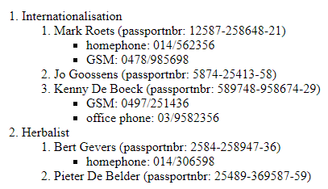
Application testing
We restart the application and now add some phone numbers:

Slide 44


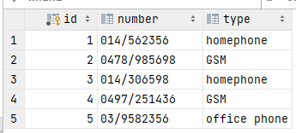
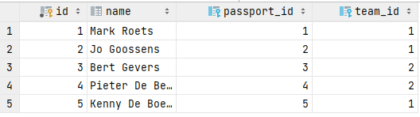

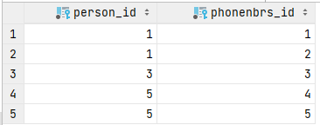

In the database
Table person_phonenbrs is automatically created by JPA created:

Slide 45
OneToMany: Unidirectional
One-way association between Person and Phone
Unidirectional because a Phone object does not need to know who its owner is.
Each person can have several phone numbers
@OneToMany association: only annotation in class Person:
Person keeps a list of phones:
@OneToMany (cascade={CascadeType.ALL})
private List<Telephone> phonenbrs = new ArrayList<>();
There is no reference to Person in Phone

Slide 46
OneToMany: Unidirectional
We end up with 3 tables:
person
phone
person_phonenbrs (will be created automatically)

Slide 47
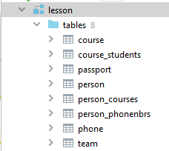
Application testing
The table structure is currently as follows:
We note that for the *-* relationship between person and course, 2 association tables were created.
Adding courses to a person or adding persons a course will cause runtime errors because this method can cause inconsistencies (more explanation about this later in this presentation)
We adapt the annotation to the students attribute in the entity Course as follows:
@ManyToMany(mappedBy="courses")
private List<Person> students = new ArrayList<>();

Slide 48
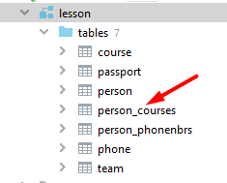
Application testing
We remove all tables from the database and run the application again. Result in the database:
Only the association table person_courses remains!
We now also modify the annotation for the courses attribute in the entity person as follows:
@ManyToMany
@JoinTable(name="coursestudent")
private List<Course> courses = new ArrayList<>();

Slide 49
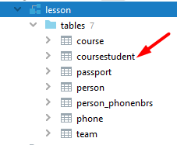
Application testing
We remove all tables from the database and run the application again. Result in the database:
The association table person_courses has been renamed to coursestudent

Slide 50
@ManyToMany: In summary
In the Entity Course:
@ManyToMany(mappedBy="courses")
private List<Person> students = new ArrayList<>();
In the Entity Person:
@ManyToMany
@JoinTable(name="coursestudent")
private List<courses> courses = new ArrayList<>();

Slide 51
Direction of association

Slide 52
Association with direction: unidirectional
If the association has a direction (= an arrowhead in the class diagram) then it is Unidirectional
=> only one entity keeps a reference to another entity. The other entity does not keep a reference to this entity.
The entity that does keep a reference indicates which multiplicity this association has.
1-1 => @OneToOne above the reference to one object
1-* => @OneToMany above the reference to a collection attribute (List)
*-1 => @ManyToOne above the reference to one object
*-* => @ManyToMany above the reference to a collection attribute (List)
In the other entity we do not mention anything
In the lesson example we had the association between Person and Phone in this way

Slide 53
Two-way association: bidirectional
If the association is to be worked out in the 2 directions (= there is no arrowhead in the class diagram) then it is Bidirectional
Both entities in the association maintain a reference to the other
One must then ensure that the association remains consistent at all times
For example, if a certain person has an association with a certain passport, that same passport must also have an association with that same person.
How?
When writing out an object that has an association with another object, only one place in the database will be used to enter the relationship, and this is the FK...
One of the 2 entities in the association must contain the "MappedBy" attribute.
Which entity with which reference depends on the type of association:
1-1 => you may choose in which entity
*-1 => no MappedBy
1-* => this entity must contain the MappedBy attribute if it is bidirectional
1-* => this entity does not have a MappedBy attribute if it is unidirectional
*-* => you may choose in which entity
The MappedBy attribute will determine where the FK will be = Owner of the relation/association

Slide 54
Optional and FetchType
= Additional properties to the association annotations
Optional: default value = true
Indicates whether the FK can be null (NA/NNA)
If you do not specify, FK: NA (default)
For example. @ManyToOne(optional = false) => the FK is mandatory (NNA)
FetchType: FetchType.EAGER or FetchType.LAZY
FetchType indicates whether you want to immediately fetch the associated objects from the database (EAGER) or not (LAZY)
Eg @OneToMany(mappedBy="team", fetch=FetchType.EAGER)
Default values for fetchtype in jpa 2.0
OneToMany: LAZY
ManyToOne: EAGER
ManyToMany: LAZY
OneToOne: EAGER
ManyToMany and OneToMany have default FetchType Lazy to avoid the initialisation of a lot of unused objects and the extra database queries that have to be run to initialise the associated objects. However, sometimes this goes wrong in jpa and the array list with associated objects is never filled up (empty ArrayList). This can be solved by specifying FetchType.EAGER with these associations.

Slide 55
Additional annotations

Slide 56
Contents
Annotations
@Transient
Enumeration
@Temporal

Slide 57
Annotations
In JPA, we use annotations to determine how the entities on the tables should be mapped.
There are 89 different annotations for persistence
We have already seen:
@Entity, @Id, @GeneratedValue, @Inheritance, @OneToOne, @ManyToOne, @ManyToMany, @JoinTable
We see 3 additional annotations in this presentation:
@Transient, @Enumerated, @Temporal
The full list of annotations can be found at:
http://docs.oracle.com/javaee/7/api/javax/persistence/package-summary.html under annotation types summary

Slide 58
@Transient
@Transient
Can be added to an attribute you do not want to make persistent.
For example:
@Transient
private int calculatedValue;
=> NO field “calculatedValue” will be created in the table corresponding to the Entity.

Slide 59
Enumeration
You often want a variable that can only take a value from a fixed set of possibilities, for example a weekday
You can use an enumeration for this.
enum Lesson day {
MONDAY, TUESDAY, WEDNESDAY, THURSDAY, FRIDAY}
This defines a new type of Lesson Day, for variables that can only have a value listed between the curly brackets.
MONDAY, TUESDAY,... we call enumeration constants
Look up all the necessary information to know how to work with an Enumeration class:
https://docs.oracle.com/javase/tutorial/java/javaOO/enum.html
https://www.w3schools.com/java/java_enums.asp
...

Slide 60
Enumeration
Points of attention for enumeration in connection with persistence:
Make enum a separate Java class
Then use the enumeration in your Entity but tell it how to make the info persistent in the database
You do this as follows:
@Entity
public class Course {
. . .
@Enumerated(EnumType.STRING)
private Lesson day

Slide 61
@Temporal
When you use a java.util.Date or java.util.Calender datatype you must use the @Temporal annotation.
For example.
@Temporal(TemporalType.DATE)
private Date start date;
@Temporal(TemporalType.DATE) = equivalent to java.sql.Date
@Temporal(TemporalType.TIME) = equivalent to java.sql.Time
@Temporal(TemporalType.TIMESTAMP) = equivalent to java.sql.Timestamp
If you forget to mention this, you will not get error messages immediately, but later, especially when you want to use the dates you entered... It is often difficult to know where the error came from. So do not forget this!

Slide 62
@Embeddable and @Embedded
In an OO application we often have more classes than there are tables in the database.
Suppose we have the class Period (quarter and year) and the class ProjectPhase (name and duedate). When persisting, we want the Period to be written as part of the ProjectPhase table.
@Embeddable
public class Period {
private int quarter, year;
public Period () {
}
. . .
}

Slide 63
@Embeddable and @Embedded
@Entity
public class ProjectPhase
. . .
@Embedded
private Period duedate;
. . .
}

